Slide 1
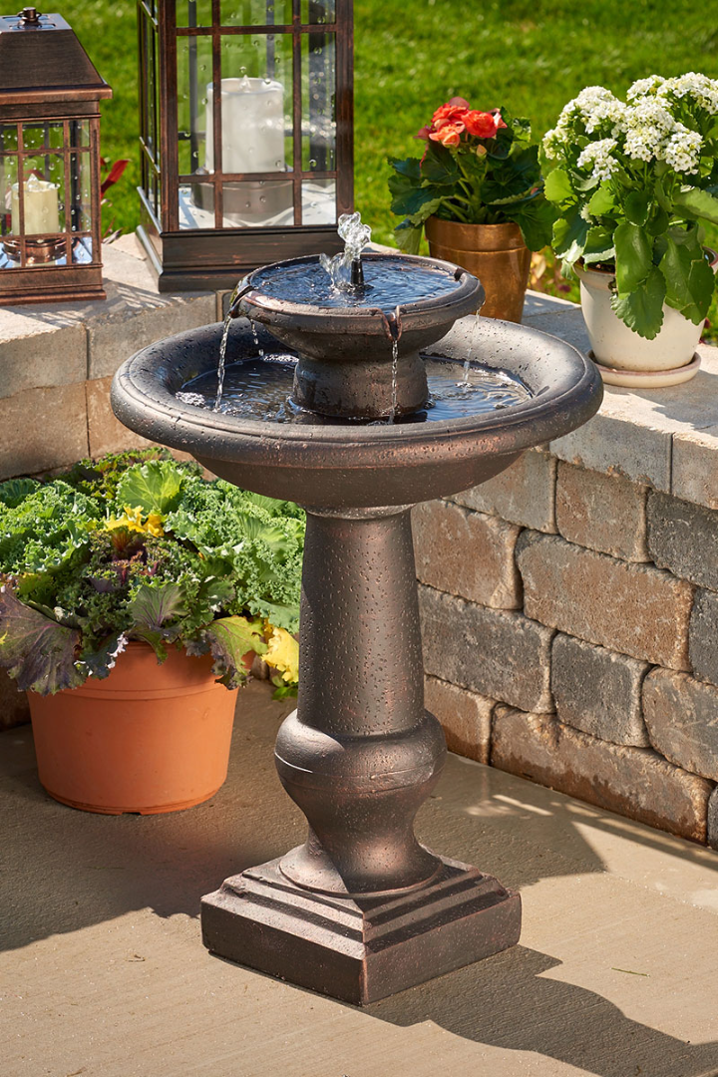
Smart Water Fountains using IOT
Upgrade your water fountains with the internet of things for a smarter, more sustainable future.
Notes:
1

Slide 2
PROGRAM:
import time
import paho.mqtt.client as mqtt
def get_water_level():
return random.uniform(0.0, 100.0)
def get_temperature():
return random.uniform(0.0, 40.0)
def get_ph_level():
return random.uniform(0.0, 14.0)
broker_address = "mqtt.eclipse.org"
port = 1883
topic = "smart_water_foundation"
client = mqtt.Client()
client.connect(broker_address, port)
try:
while True:
# Get sensor data
water_level = get_water_level()
temperature = get_temperature()
ph_level = get_ph_level()
END

Slide 3
# Create JSON payload
payload = {
"water_level": water_level,
"temperature": temperature,
"ph_level": ph_level
}
# Publish data to the broker
client.publish(topic, str(payload))
# Print for debugging (optional)
print(f"Published: {payload}")
# Delay for a while (adjust as needed)
time.sleep(10) # e.g., every 10 seconds
except KeyboardInterrupt:
client.disconnect()
END

Slide 4
OUTPUT:
Published: {'water_level': 43.765681607967534, 'temperature': 35.28613649094769, 'ph_level': 2.834535224079818}
END
These lines indicate that the script has generated simulated sensor data and published it tothe MQTT broker. The data is in the form of a dictionary containing water level, temperature, and pH level readings.
These values are random in this example, but in a real-world application, they would be coming from actual sensors.

